Slide 1
LEARN IT ALL!
Presented by:
CHARUTA BIWALKAR, NOOPUR KAMBLE and Leandra Menezes
Guided by: Professor vishal chawla

Slide 2
PROJECT IDEA
Develop an online tutorial website to facilitate learning and teaching through digital media
Video tutorials across various domains such as Academics, Musical Instruments and Cooking. Also include, DIY hacks and Interview Tips
Users can be both tutors as well as students
Offer digital enthusiasts a perfect balance between their academic aspirations and their hobbies

Slide 3
PROJECT OBJECTIVES
Provide a common platform for tutors and students
Ease the process of learning through digital media such as online video tutorials
To motivate people to upload their work/content of the domains they are proficient in
Quicker way to do hands-on tasks such as cooking and other household activities

Slide 4
SITE MAP
Home
Categories
About Us
Careers
User
Contact Us
Academics
Musical Instruments
Quick Bites
DIY Hacks
Interview Tips
Register
Check news feed
Course Status
Upload Content

Slide 5
TECHNOLOGIES COVERED & RESPONSIBILITIES
HTML & HTML5
CSS & CSS3
JavaScript – Validation and tabs
Bootstrap - Carousel, Dynamic tabs, Glyphicons, Jumbotron
PAGE RESPONSIBILITIES AS A TEAM:
Charuta: Login, Contact Us, Media Queries
Noopur: Academics, Music, JavaScript, Upload File form, About Us
Leandra: Home, Profile, Beginners, User Registration, Careers

Slide 6
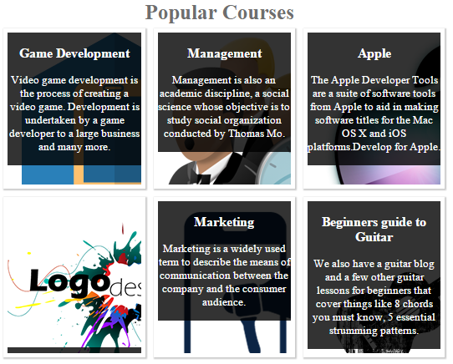
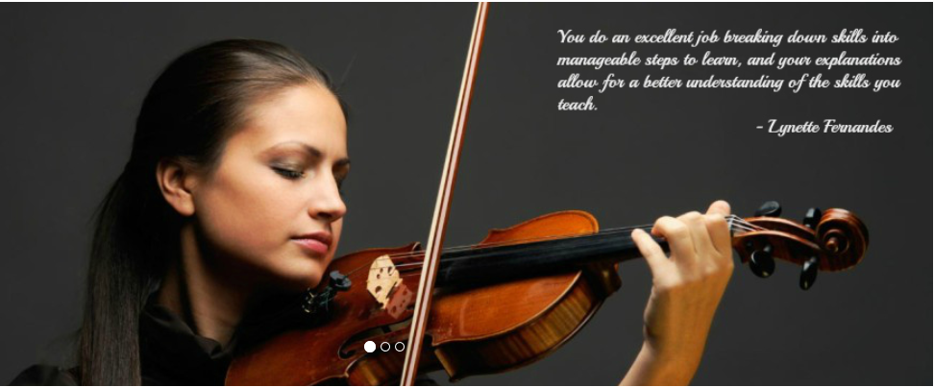
PROJECT HIGHLIGHTS
On Hover Image
On hover, the content slides down to display an attractive image to the user.
Using: HTML & CSS
Slider
Implemented a slider of images using carousel on the Music page and displaying testimonials written by users.
Using: Bootstrap and CSS

Slide 7
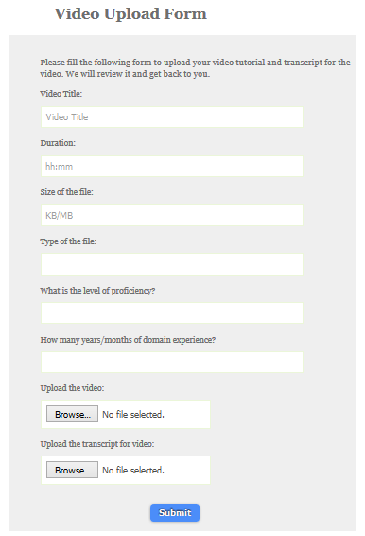
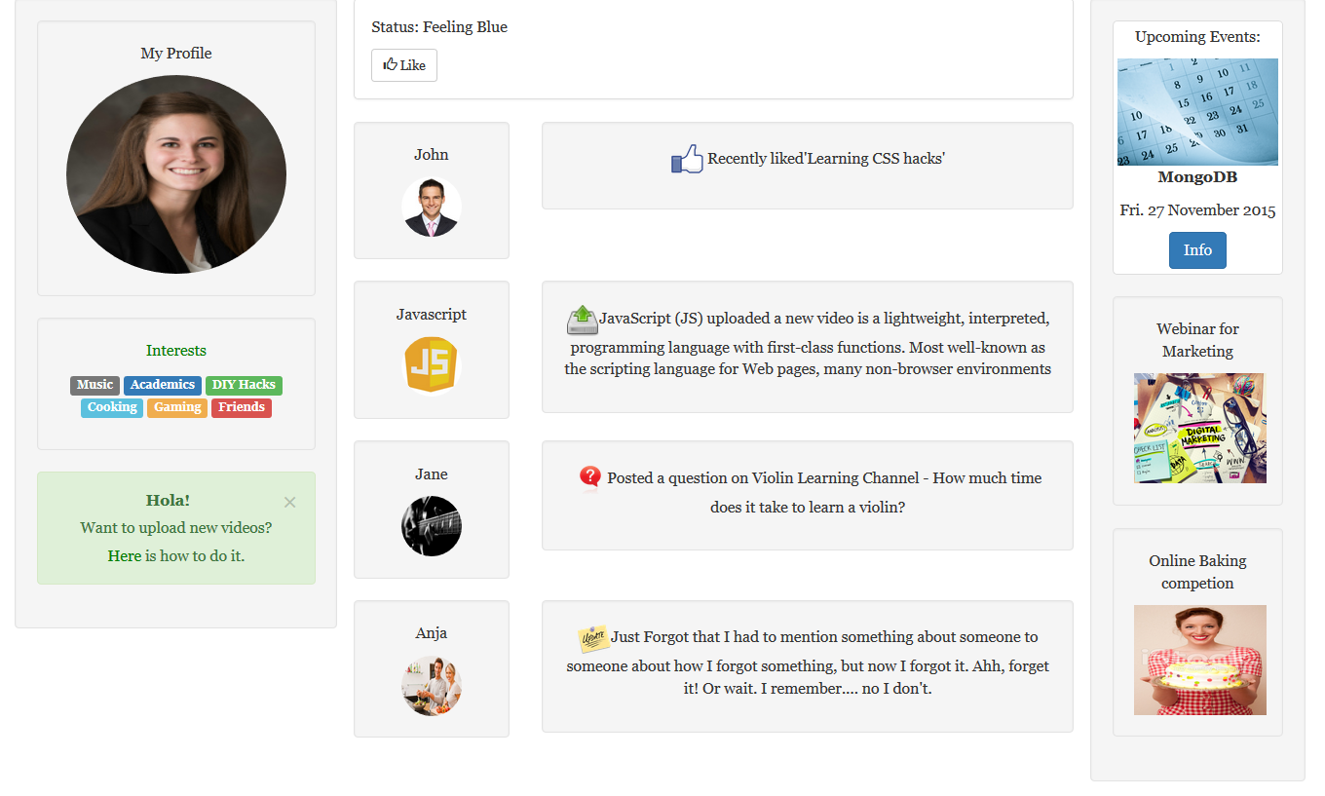
PROJECT HIGHLIGHTS
Upload Form
To upload new content, user has to fill this form. It has been validated using JavaScript function to check for proper input from the user.
Using: HTML and CSS
Profile page
Once a user logs in, he can view his profile, newsfeed and upload new content to his channel.
Using: HTML & CSS

Slide 8
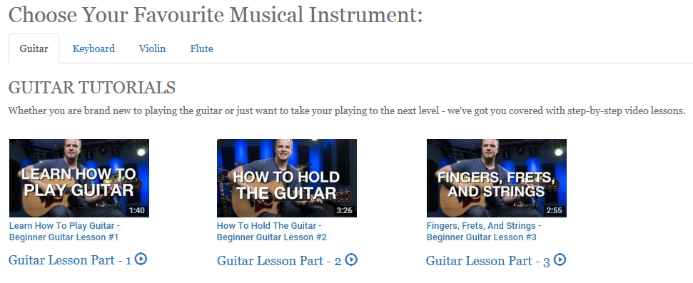
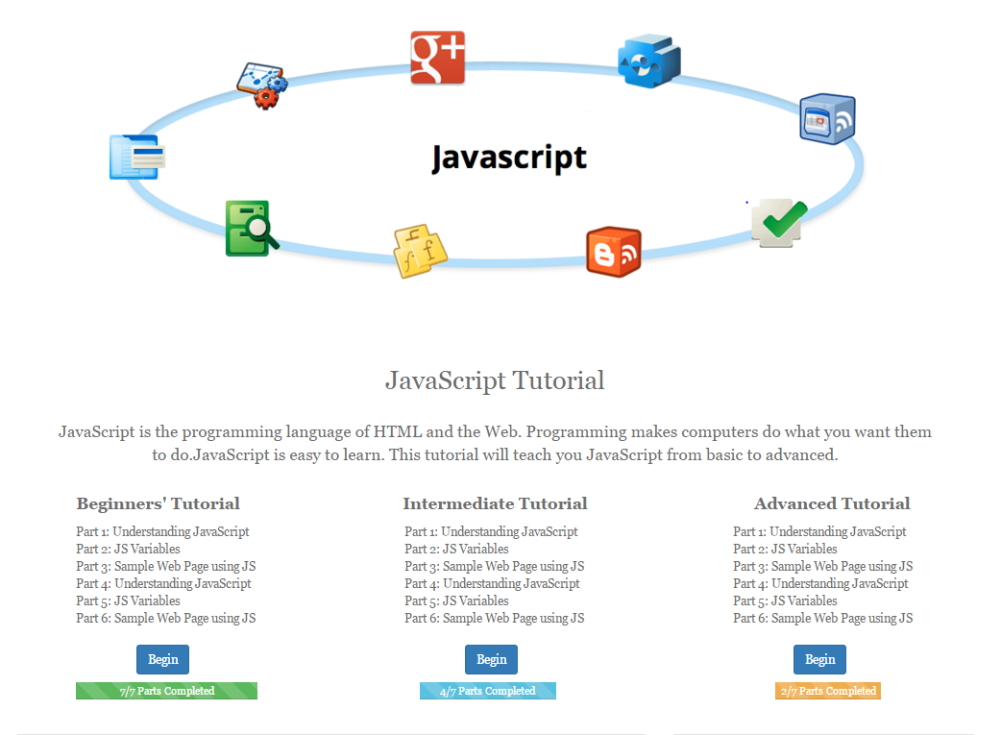
PROJECT HIGHLIGHTS
Music page – Tabs
Implemented 4 tabs to show user different types of instruments he can choose from.
Using: Bootstrap
JavaScript page
This page guides the user through 3 levels of the tutorial as displayed. There is a progress bar to monitor user’s progress.
Using: Bootstrap

Slide 9
FUTURE SCOPE
Designing pages for other categories like DIY Hacks and Interview Tips
Using advanced front-end technologies like jQuery, Bootstrap
Implementing back-end technologies like PHP to upload and store videos
Enhancing the User Interface to improve user experience
In future, attempting to host the website exclusively for Northeastern students

Slide 10
Thank You!

